Slide 1
 | Hidden layer 1 | Hidden layer2 | Hidden layer3 | Test AUC | Test AUC after fine tuning | Train AUC | Train AUC After finetuning
1 | 100 | 50 | - | 0.89144 | 1 | 0.87628 | 1
2 | 100 | 100 | - | 0.885 | 1 | 0.882 | 1
3 | 200 | 100 | - | 0.923 | 1 | 0.920 | 1
4 | 100 | 200 | - | 0.8838 | 1 | 0.877 | 1
5 | 300 | 100 | - | 0.9303 | 1 | 0.9306 | 1
6 | 400 | 100 | - | 0.939 | 1 | 0.930 | 1
7 | 700 | 100 | - | 0.9494 | 1 | 0.941 | 1
8 | 100 | 400 | - | 0.859 | 1 | 0.856 | 1
9 | 300 | 100 | 100 | 0.9174 | 1 | 0.9177 | 1
10 | 300 | 100 | 200 | 0.920 | 1 | 0.92073 | 1
11 | 400 | 300 | 100 | 0.9145 | 1 | 0.923 | 1
12 | 700 | 500 | 100 | 0.948 | 1 | 0.939 | 1

Slide 2
Hidden Layer1=100;
Hidden Layer2=50;
After fine tuning
After fine tuning

Slide 3
Hidden Layer1=100;
Hidden Layer2=100;
After fine tuning
After fine tuning

Slide 4
Hidden Layer1=200;
Hidden Layer2=100;
After fine tuning
After fine tuning

Slide 5
Hidden Layer1=100;
Hidden Layer2=200;
After fine tuning
After fine tuning

Slide 6
Hidden Layer1=300;
Hidden Layer2=100;
After fine tuning
After fine tuning

Slide 7
Hidden Layer1=400;
Hidden Layer2=100;
After fine tuning
After fine tuning

Slide 8
Hidden Layer1=700;
Hidden Layer2=100;
After fine tuning
After fine tuning

Slide 9
Hidden Layer1=100;
Hidden Layer2=400;
After fine tuning
After fine tuning

Slide 10
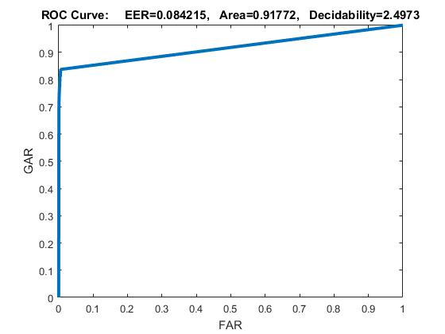
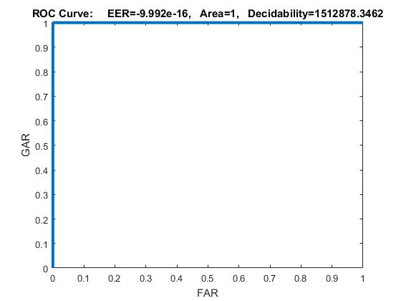
Hidden Layer1=300;
Hidden Layer2=100;
Hidden Layer3=100
After fine tuning
After fine tuning

Slide 11
Hidden Layer1=300;
Hidden Layer2=100;
Hidden Layer3=200
After fine tuning
After fine tuning

Slide 12
Hidden Layer1=400;
Hidden Layer2=300;
Hidden Layer3=100
After fine tuning
After fine tuning

Slide 13
Hidden Layer1=700;
Hidden Layer2=500;
Hidden Layer3=100
After fine tuning
After fine tuning

Slide 14
AUC 1 | AUC 2 | AUC3 | AUC4 | AUC5 | AUC6 | Avg AUC
0.9732 | 0.9733 | 0.970 | 0.973 | 0.967 | 0.970 | 0.967
Hidden Layer1=200,300,400;
Hidden Layer2=100,100,200;

